Slide 1
Data Warehousing Basics
Operational Data Store
Level - Learner

Slide 2
Overview
An ODS is usually designed to contain low-level or atomic (indivisible) data (such as transactions and prices) with limited history that is captured "real time" or "near real time" as opposed to the much greater volumes of data stored in the data warehouse generally on a less-frequent basis.
Notes:
Now you know what is operational data and the need of Operational data.
But when the business needs to make decisions or strategies it needs informational system which is nothing but our Data Warehouse. Here you learn what is a data warehouse and how we design it.
Welcome to Data Warehousing Fundamentals!!!!

Slide 3
Objectives
After completing this session, associate will be able to :​
Define an ODS?
List the differences between ODS and Data warehouse?
Describe the classification of ODS?
List the advantages of ODS?

Slide 4
Operational Data Store
Need for ODS
To obtain a “system of record” that contains the best data that exists in a legacy environment as a source of information.
Best data implies to be:
Complete
Up to date
Accurate
In conformance with the organization’s information model.

Slide 5
ODS Overview
What is an ODS?
The typical definition of an operational data store (ODS) is that it’s a set of logically related data structures within a database.
The data within an ODS is integrated, volatile and at a non-historical granular level that is designed to address a set of operational functions for a specific business purpose.
The operational data store is a physical area in the data warehouse that contains the latest snapshot of the operational data.

Slide 6
ODS Features
The Operational Data Store (ODS) is defined to be a structure that is:
Subject oriented
Integrated
Volatile
Current (Non-historical)
Detail

Slide 7
Subject Oriented
The ODS contains specific data that is unique to a set of business functions. The data therefore represents a specific subject area.
ODS’ are designed and organized around the major data subjects of a corporation – like CUSTOMER or PRODUCT. They are not organized around specific applications or functions – like Order Entry or Accounts Receivable.

Slide 8
Integrated
Data in the ODS is sourced from various legacy applications.
The source data is taken through a set of ETL operations that includes cleansing and transformative processes.
These processes are based on rules that have been created through business requirements for data quality and standardization.
ODS’ represent a collectively integrated image of subject oriented data that is pulled in from potentially any operational system.
If the CUSTOMER subject is included, then all of the CUSTOMER information in the enterprise is fair game for inclusion in the ODS.

Slide 9
Volatile
Since an ODS is current valued, it’s subject to change on a frequency that supports the definition of “current”.
That is, it’s updated to reflect the changes occurring in the systems that feed it in the true OLTP sense.
Therefore, identical queries, made at different times, will likely yield different results because the data has been updated with changes.

Slide 10
Current Valued & Detailed
The data in the ODS is up-to-date and is a current status of data from the sourcing applications.
Data in the ODS is primarily used to support operational business functions.
This means that there is a specific level of granularity based on business requirements that dictate the level of detail that data in the ODS will have.

Slide 11
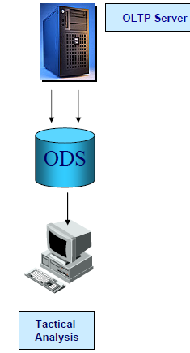
Architecture of ODS
ODS Data resolves data integration issues.
Data physically separated from production environment to insulate it from the processing demands of reporting and analysis.
Access to current data facilitated.

Slide 12
Classification of ODS
Classifications | Comment
Class 1 | Refresh cycle: Real-time Degree of transformation: Low due to compressed timeframes
Class 2 | Refresh cycle: ½ - 1 hour store and forward mechanism Degree of transformation: Medium
Class 3 | Refresh cycle: Daily. Traditional batch process Degree of transformation: High
Class 4 | Refresh cycle: Ad hoc, often involving preprocessed, value-added information from a data warehouse Degree of transformation: Highest

Slide 13
Classification of ODS (Cont.)
Class I – Updates of data from operational systems to ODS are synchronous.
Class II – Updates between operational environment & ODS occurs between 2-3 hour frame.
Class III – synchronization of updates occurs overnight.
Class IV – Updates into the ODS from the DW are unscheduled.

Slide 14
Benefits of ODS
The following are the benefits of ODS:
Integrates the data.
Synchronizes the structural differences in data.
High transaction performance.
Serves the operational and DSS environment.
Transaction level reporting on current data.

Slide 15
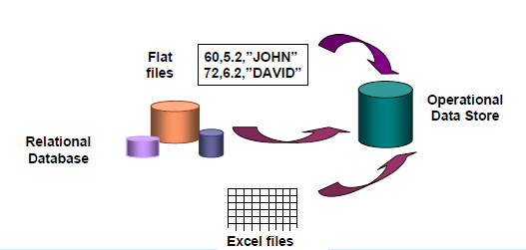
Benefits of ODS (Cont.)

Slide 16
Disadvantages of ODS
The following are the disadvantages of ODS:
You need to plan for downtime during each run of ETL processes. The more frequently you are running the ETL processes, the more downtime you need to plan.
You will have to compromise between availability and data consistency.
Unnecessary disk storage consumption.

Slide 17
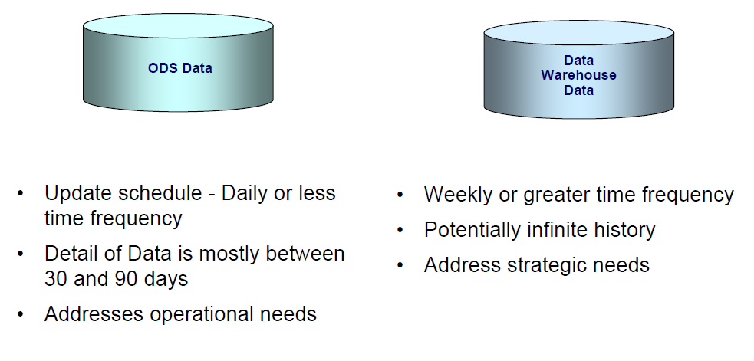
ODS: Update Schedule

Slide 18

ODS vs Data Warehouse Characteristics
Parameters | ODS | Data Warehouse
Integrated and subject oriented
Updated By Transactions
Stores Summarized data
Used for Strategic decisions
Used for Managerial level
Used for tactical details
Contains current and detailed data
Lengthy historical perspective

Slide 19
Real Life Example for ODS
Customer Relationship Management: A common data source for business intelligence, CRM systems do just what they say, they process and store customer profile and behavior information, like purchase activity.
CRM systems are used in the same way to manage business contacts, clients, contract wins and sales leads.
CRM is often thought of as a business strategy that enables businesses to:
Understand the customer
Retain customers through better customer experience
Attract new customer
Win new clients and contracts
Increase profitably
Decrease customer management costs

Slide 20
Questions

Slide 21
Test your Understanding
Explain Fact
Explain Dimensions
Relate real time examples of fact and dimensions

Slide 22
Recap
After completing this session, associate should be able to :​
Define an ODS?
List the differences between ODS and Data warehouse?
Describe the classification of ODS?
List the advantages of ODS?

Slide 23
Thank You
You have successfully completed the session on Operational Data Store.

